Slide 1
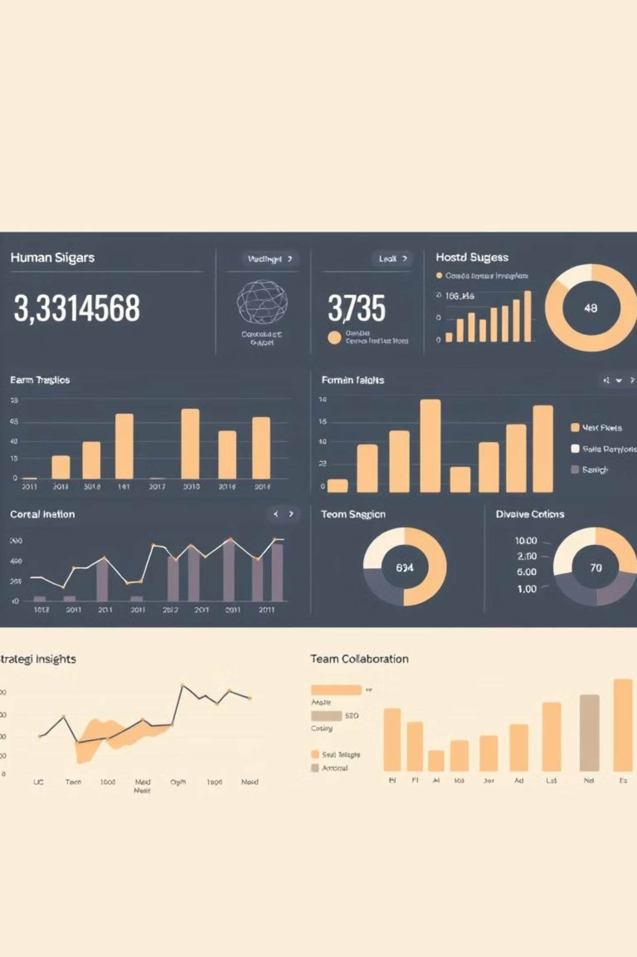
HR Analytics This presentation details our comprehensive HR Analytics initiative, designed to empower human resources professionals with data-driven insights. Our goal is to transform reactive HR practices into proactive, strategic interventions that foster a thriving workforce.
Presented By – Group 1

Slide 2

Chaitrali Devale
Moumita Dasgupta
Sylvia
Sandeep Kumar Das
Mentor : Rajanidevi Gupta
Co mentor- Shegjibaigari Ashraf
Prasanna Kulkarni
Vishal Kumar

Slide 3

The Challenge: Navigating HR Without Clear Data
"In today's dynamic business environment, making informed HR decisions without robust data is like navigating a ship without a compass. We needed clarity, foresight, and actionable intelligence to truly support our most valuable asset – our people."
Before this initiative, HR operations often relied on intuition and anecdotal evidence, leading to reactive decision-making and missed opportunities for strategic workforce planning. This project aimed to address this fundamental gap.

Slide 4
Our Approach to Solving the Problem
Collected and cleaned HR data to remove errors, duplicates, and missing values.
Explored the dataset to understand employee details such as age, salary, department, and attrition.
Created dashboards in Excel, Power BI, and Tableau to visualize trends and patterns.
Used SQL queries to extract specific information, such as attrition by department, salary distribution, and performance levels.
Compared results across different tools to check accuracy and consistency.
Identified key insights that highlight major HR challenges.
Prepared recommendations to help management make better decisions and improve employee retention.

Slide 5
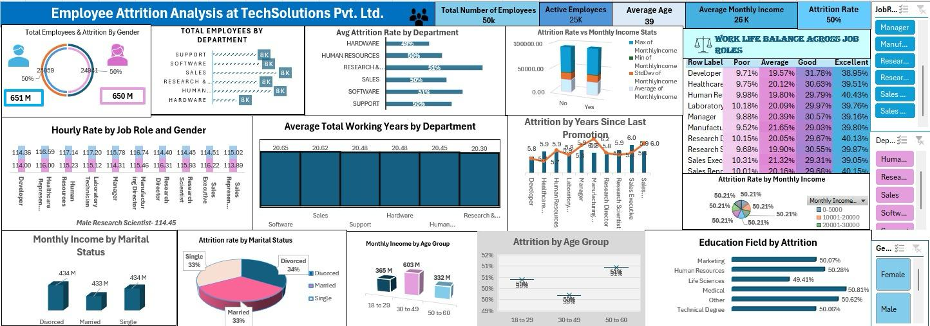
Excel Dashboard

Slide 6
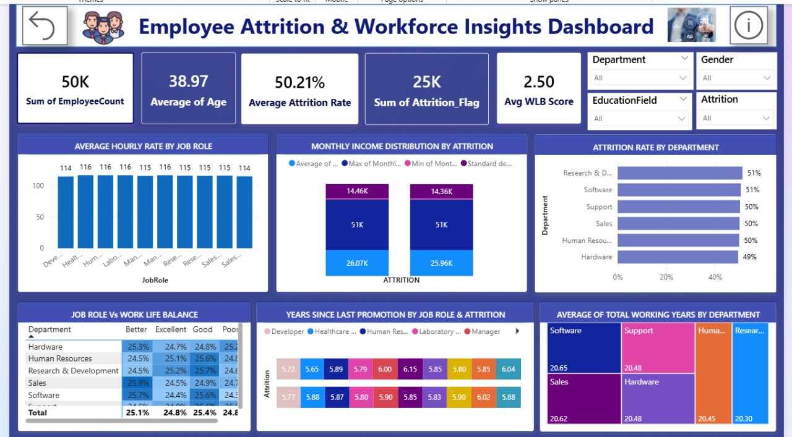
Power BI Dashboard

Slide 7
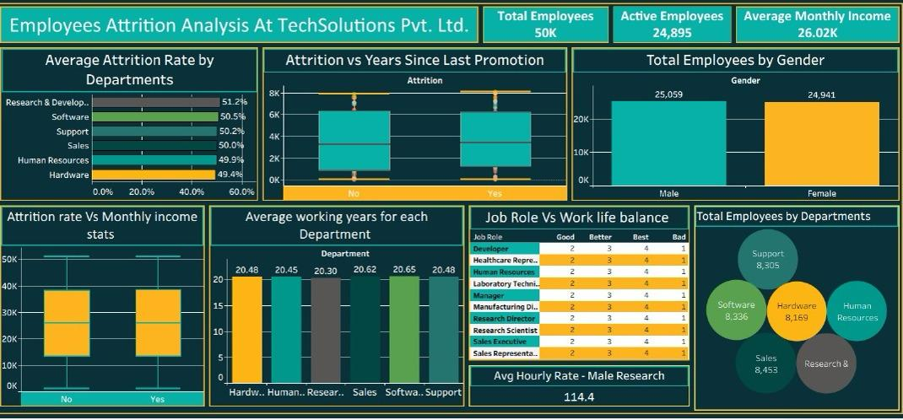
Tableau Dashboard

Slide 8
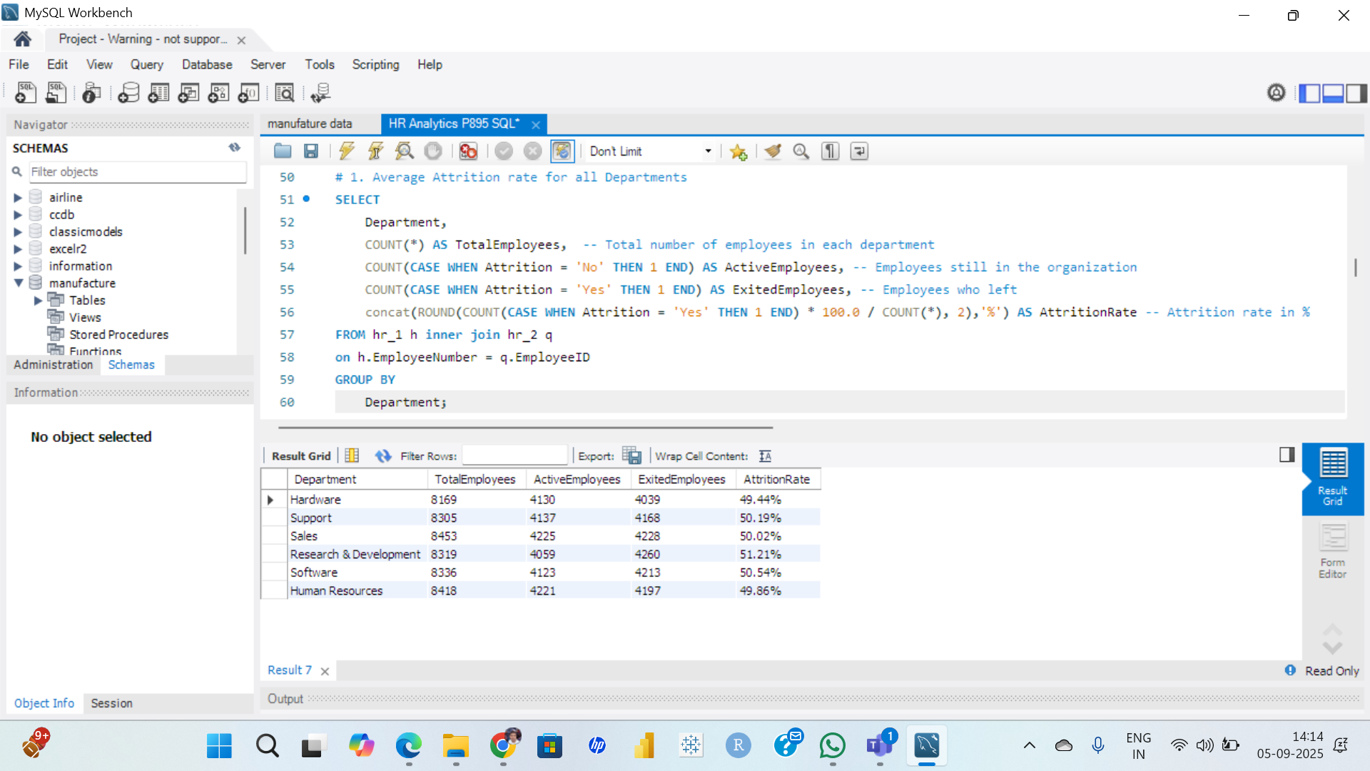
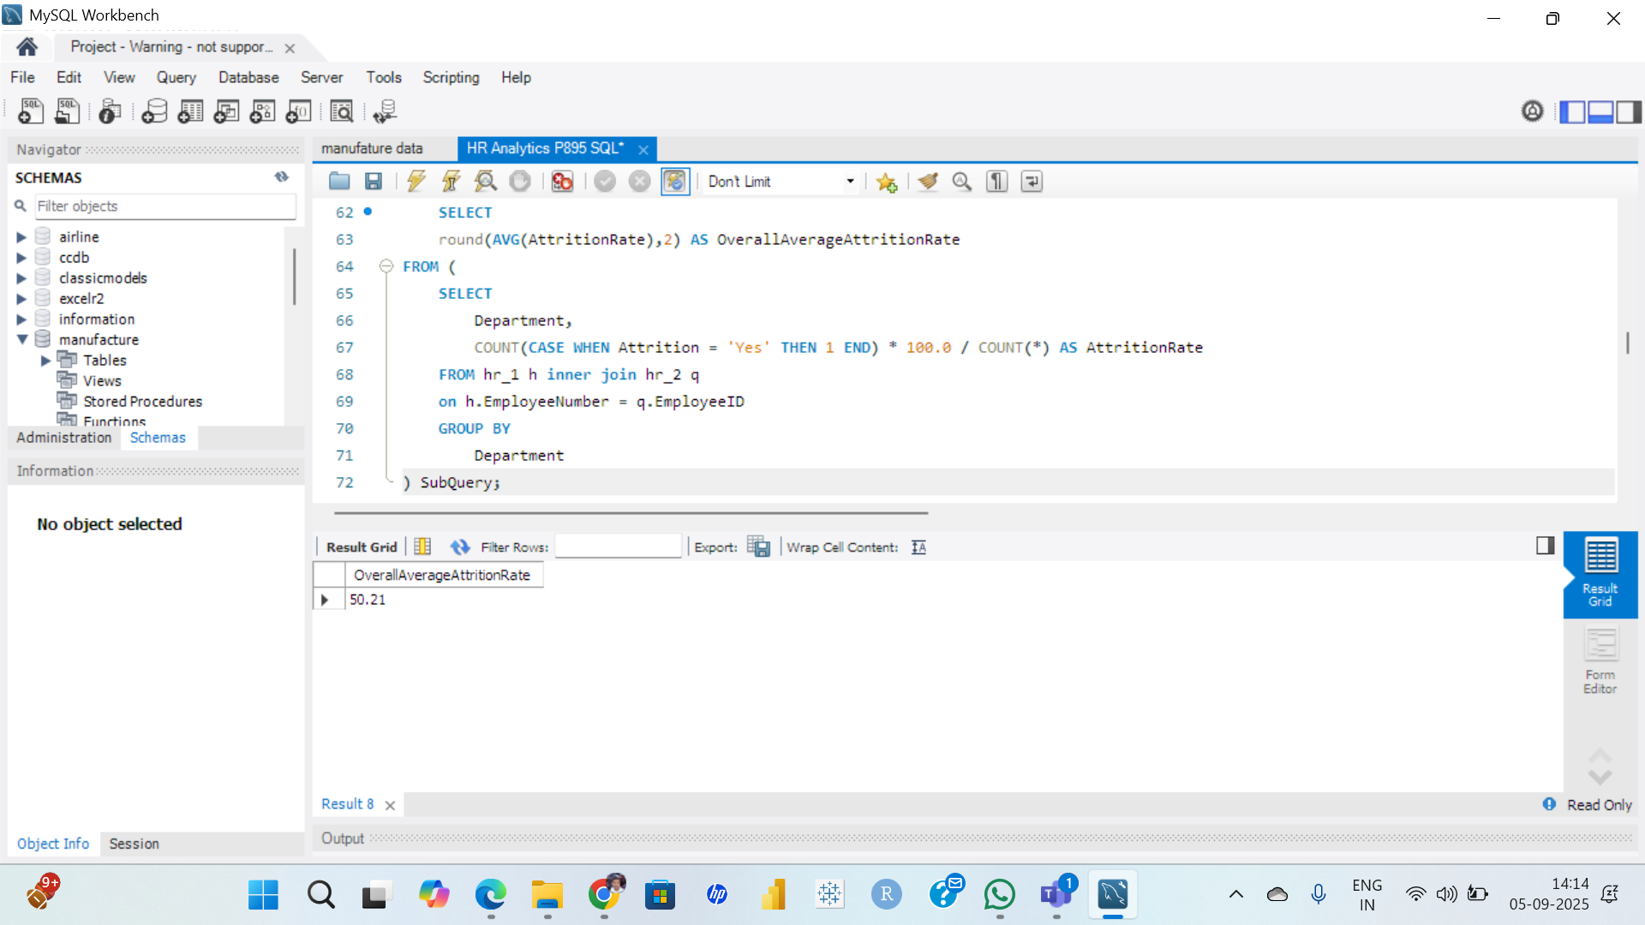
SQL Queries
1.Average Attrition rate for all Departments

Slide 9
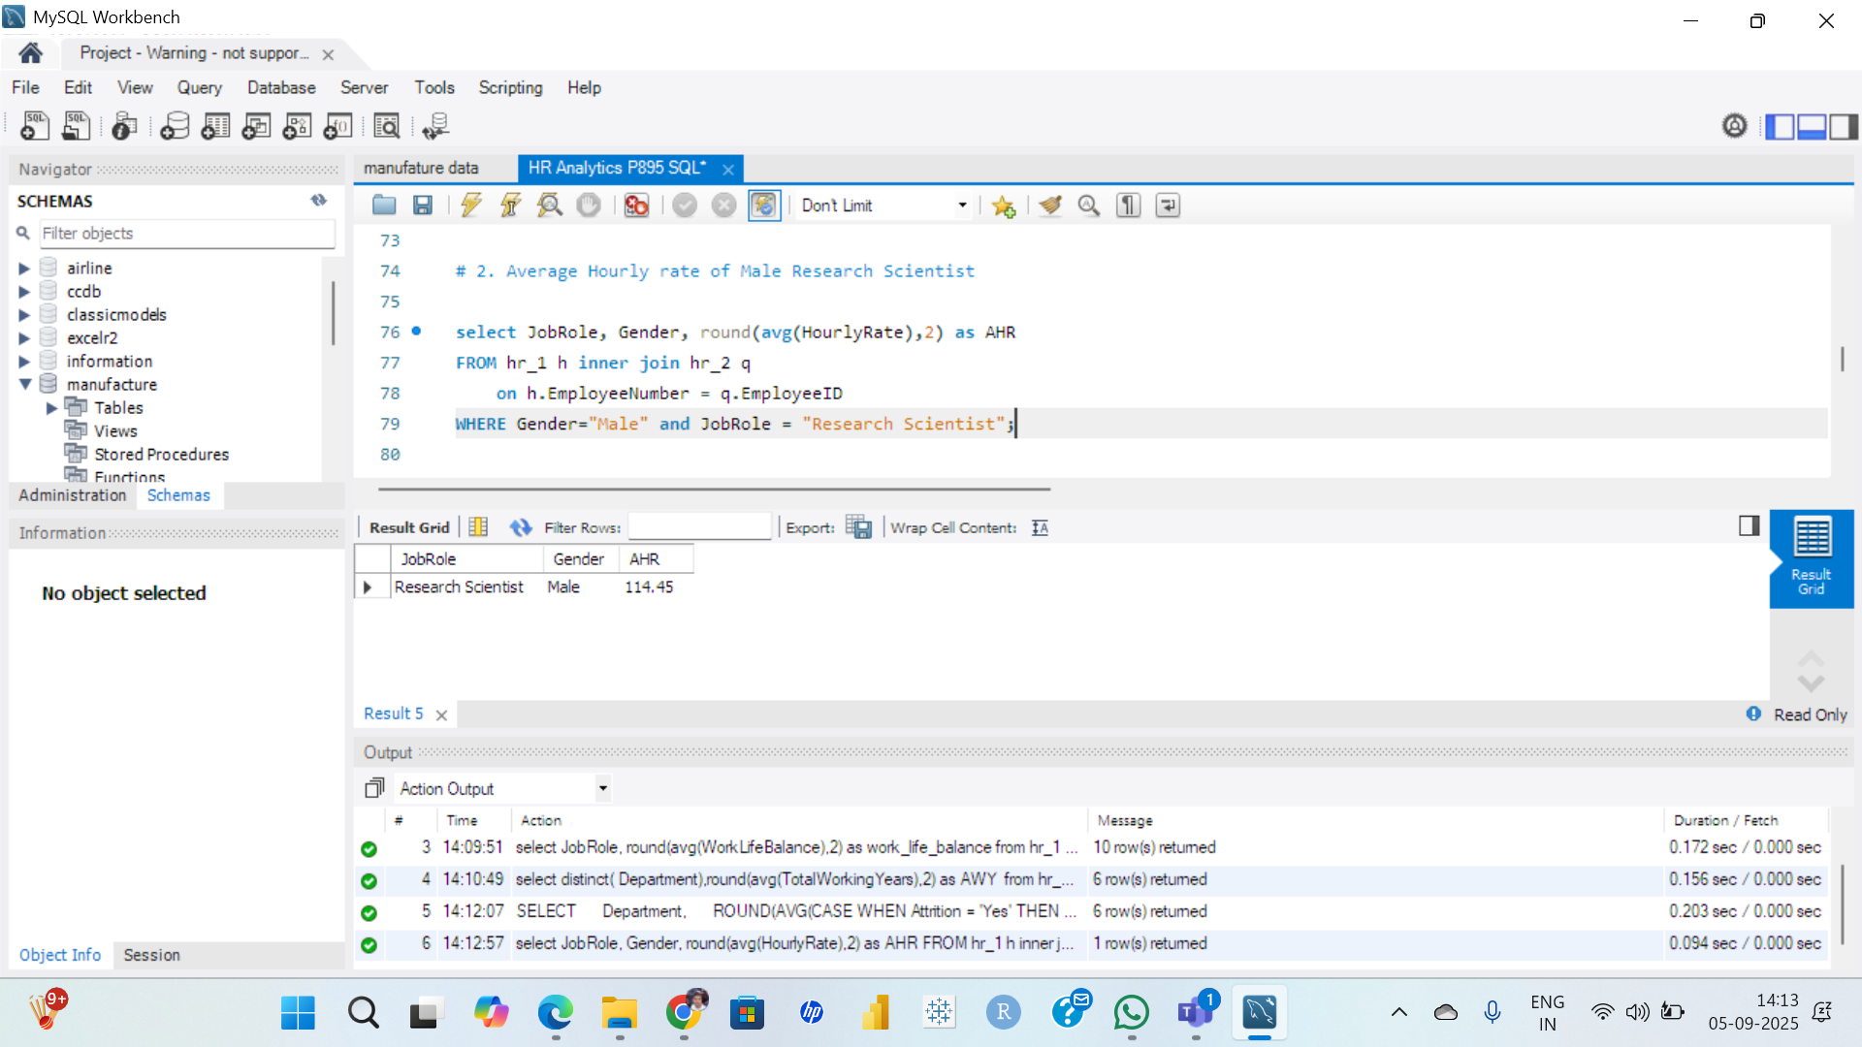
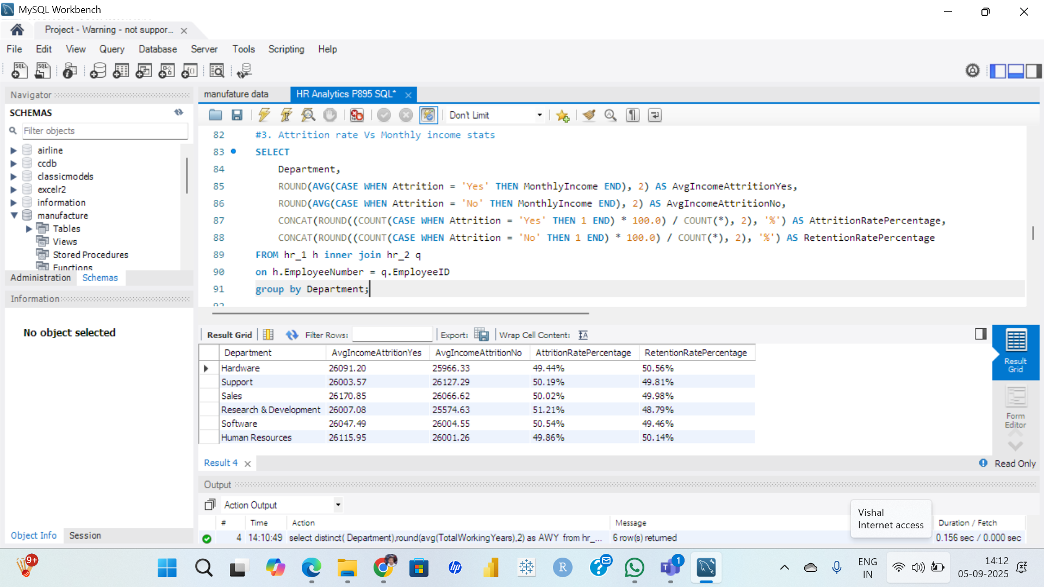
2 . Average Hourly rate of male Research Scientist
3 . Attrition rate Vs Monthly Income Stats

Slide 10
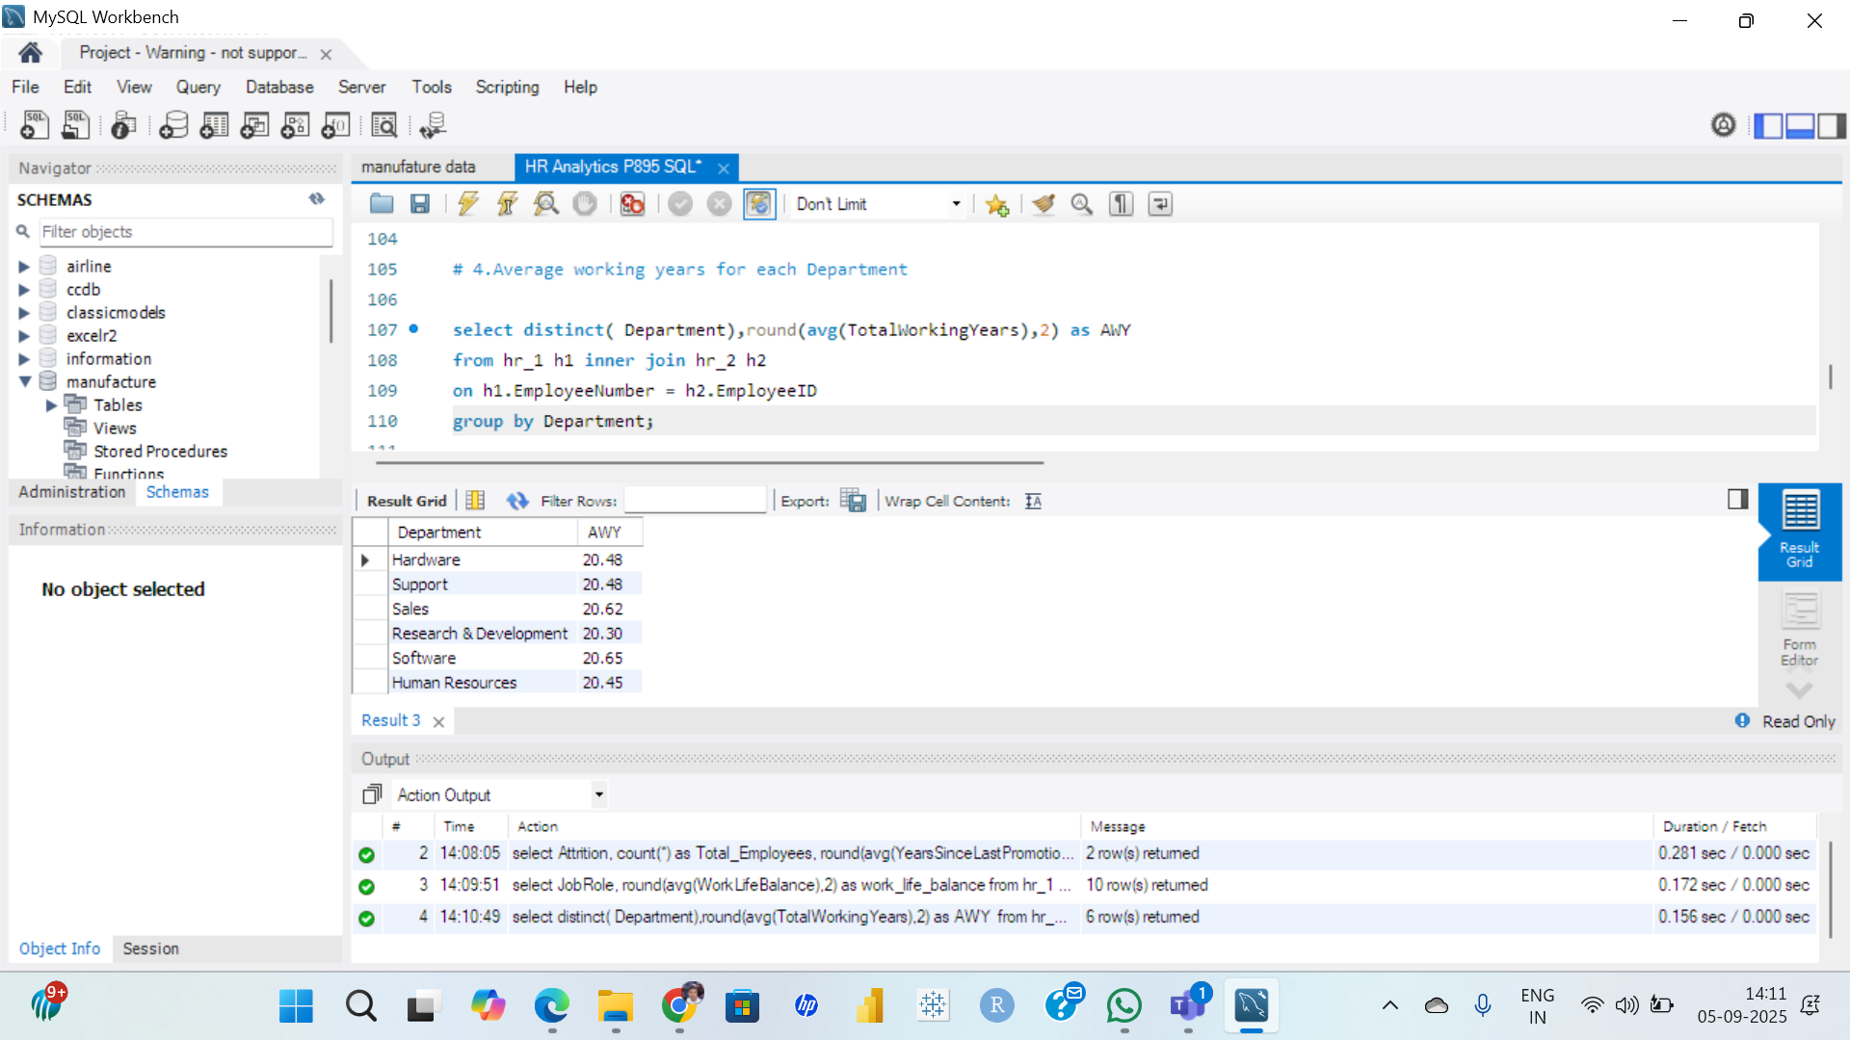
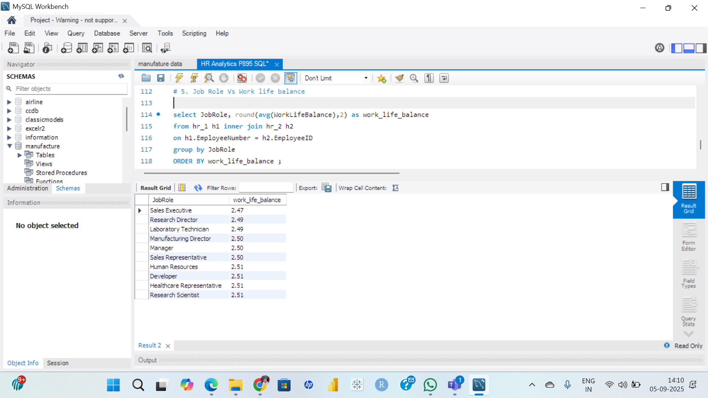
4 . Average Working Years For Each Department
5 . Job Role Vs Work Life Balance

Slide 11
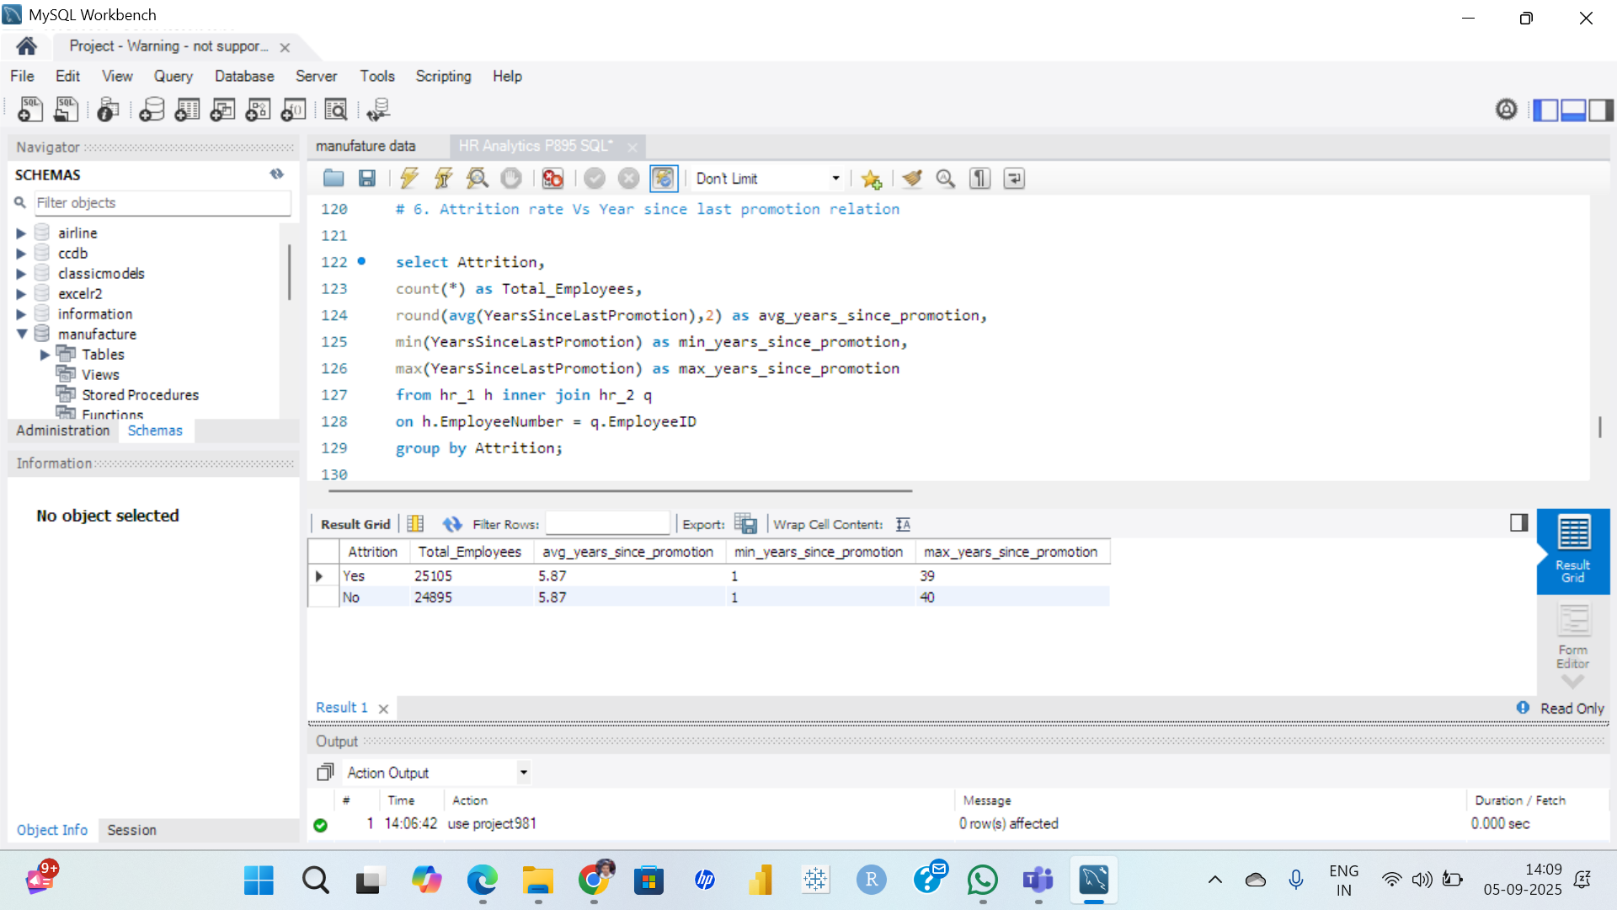
6 . Attrition Rate Vs Year Since Last Promotion Relation

Slide 12
Key Insights
Attrition Rate
The overall attrition rate is around 50%, which is very high.
By Department
Highest attrition is seen in Research & Development (51%) and Software (51%).
Lowest attrition is in Hardware (49%).
By Income
Employees with monthly income between 10001–30000 have the highest attrition rate (50.21%).
Lower salaries strongly impact employee retention.
By Marital Status
Divorced employees (34%) show slightly higher attrition compared to Singles (33%) and Married (33%).
By Age Group
Highest attrition is among employees aged 30–49 years.
Younger employees (18–29) also show notable attrition due to career shifts.
By Work-Life Balance
Employees with Poor or Average work-life balance are more likely to leave.
Better work-life balance improves retention.
By Education Field
Attrition is highest in Medical (50.81%) and Human Resources (50.28%).
Years Since Last Promotion
Employees with 5–6 years since last promotion show higher attrition, indicating dissatisfaction with career growth.

Slide 13
Recommendations
Reduce Attrition in High-Risk Departments
Focus on Research & Development and Software teams with targeted retention programs.
Salary Improvements
Review and increase salaries, especially for employees earning ₹10K–30K, as low income is directly linked to attrition.
Career Growth Opportunities
Offer timely promotions and clear growth paths to reduce dissatisfaction among employees waiting 5–6 years.
Work-Life Balance Programs
Provide flexible working hours, wellness programs, and hybrid work options to improve employee satisfaction.
Age-Specific Strategies
For 30–49 year olds: Provide leadership training and career advancement.
For younger employees: Offer mentoring and skill development to keep them engaged.
Departmental Focus
In Medical and HR fields, introduce employee engagement initiatives to address high attrition.

Slide 14
Thank You !

